Slide 1

Rules for the final
Goal: not failing the course in a stupid way

Slide 2



You will be given the exam which has some draft space.
On the table, you only need your pens and the one page of notes, both sides (handwritten or printed).
2
Rules for the final

Slide 3

Don’t talk, don’t laugh, don’t cry...
3
Rules for the final

Slide 4
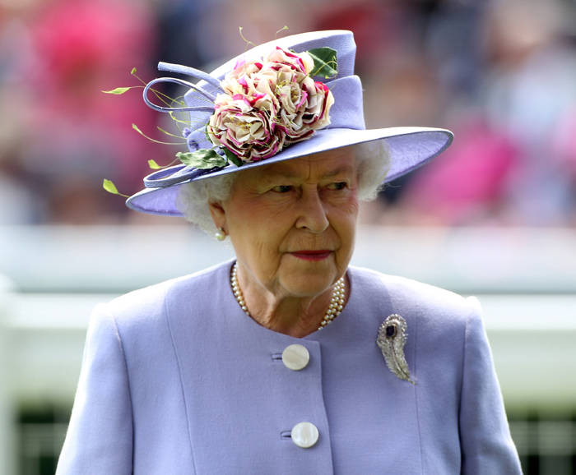

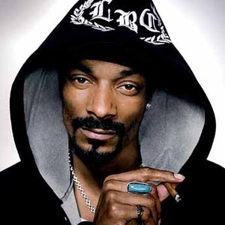
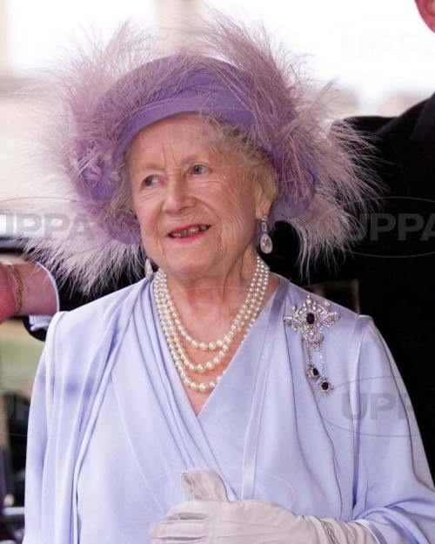
No hats, no hoods, no bandanas.
4
Rules for the final

Slide 5
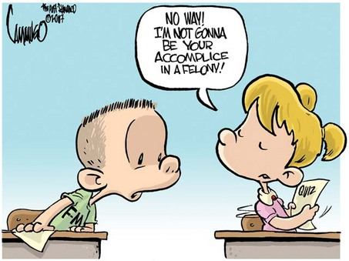
Don’t look at someone’s copy.
Don’t allow someone to look at your copy.
5
Rules for the final

Slide 6

Go to the washroom before the class. Students aren’t allowed to wander around during an exam so we’ll go to the washroom with you.
6
Rules for the final

Slide 7

My rules for the final
Goal: knowing what to study
7
Rules for the final

Slide 8

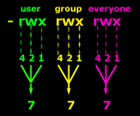
Very little solely on what was taught before the midterm.
No writing, reading or correcting C code. You should be able to explain forking and vfork though.
8
Rules for the final

Slide 9
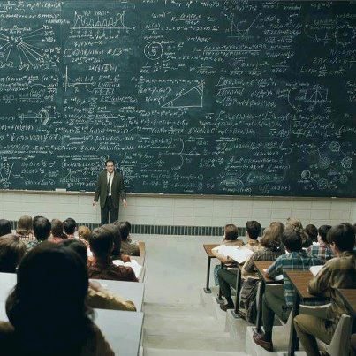
Don’t worry.
There are still a few things…
9
Rules for the final

Slide 10
Loops
Functions
Processes
Text processing
Network
10
Rules for the final

Slide 11
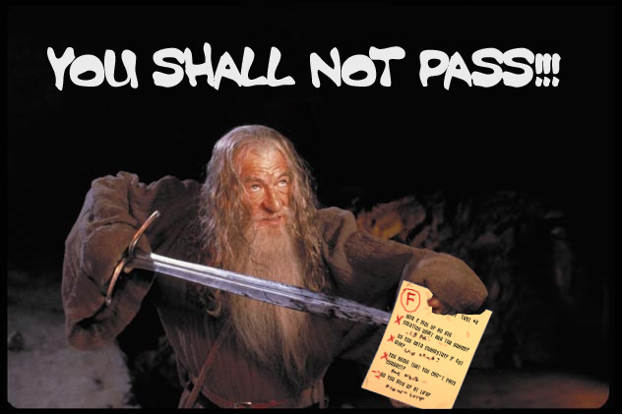
Not knowing scripting isn’t an option.
11
Rules for the final

Slide 12
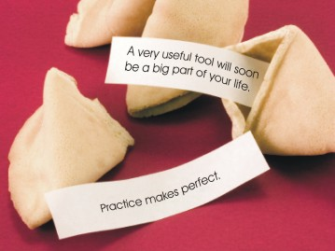
12
Rules for the final

